Slide 1
Landscape Effects from 2021 California Wild Fires
Wednesday - March 25, 2026
Jordyn Fulton | GEOL 4002 | Luttrell

Slide 2
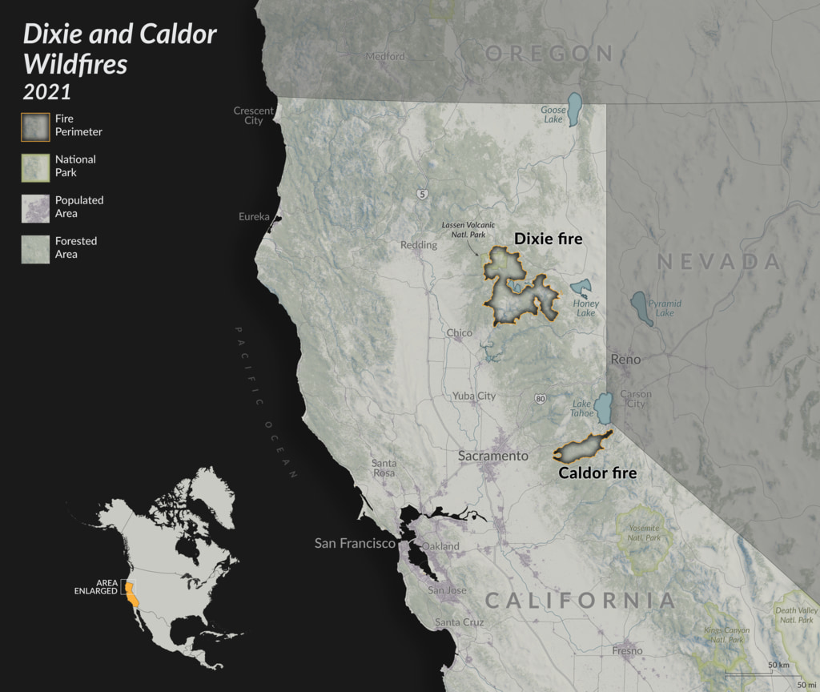
Project Question: How is Sierra Nevada’s vegetation impacted by wildfires?
Concept and Research Background Information
Transformational erosion and deposition can happen as a result of runoff being able to move fast with ground cover foliage burned out of the way. DeLong et.al. (2017) plotted landscape changes detected by LiDAR over Chiricahua Mountains, Arizona
Since California experiences frequent large scale wildfires, there is a better supply of comparative data .
Image retrieved from NASA (2022)

Slide 3
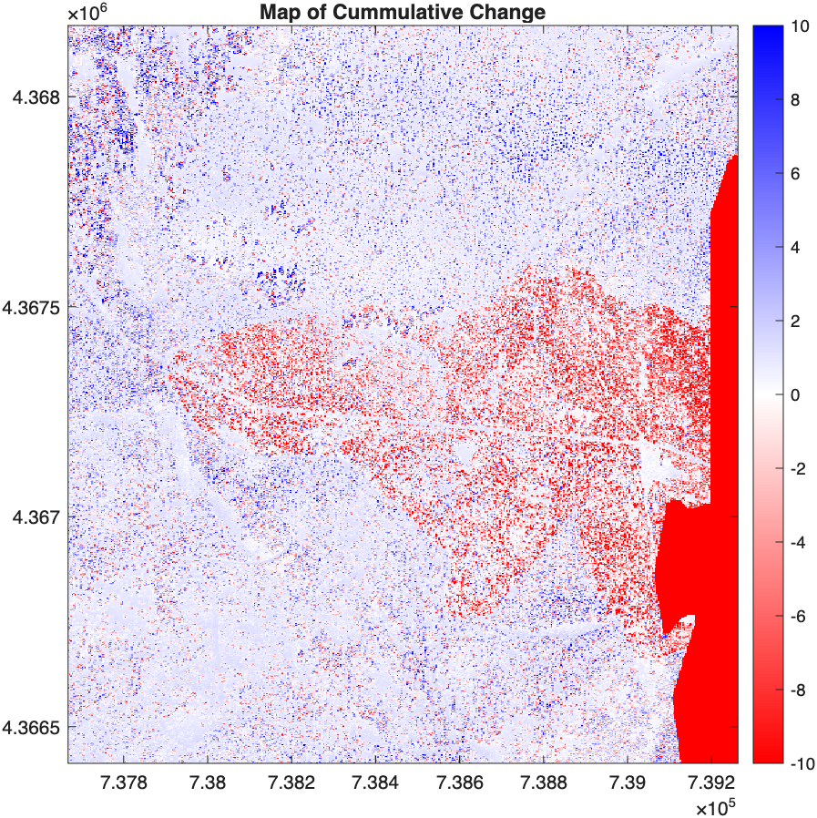
Method of Analysis
Area of Study
Sierra Nevada, California, south west of Lake Tahoe, an area impacted by the Caldo Wildfire
Gathering Data
Retrieved LiDAR data of survey area from 2021 and 2022 using OpenTopography.
Used MATLAB to write a program that displayed hillshades of surveyed area.
Forming Analysis
Create Matlab script that will plot and take the difference between the two sets of point cloud data in order to see the cumulative change in landscape in one figure.

Slide 4
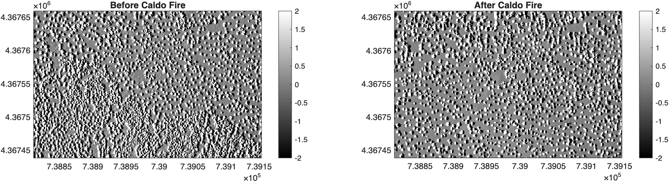
Results
Figure 3
Differenced Digital Surface Model of Sierra Nevada

Slide 5
Thank you
References:
DeLong, Stephen B., et al. “Post-Wildfire Landscape Change and Erosional Processes from Repeat Terrestrial Lidar in a Steep Headwater Catchment, Chiricahua Mountains, Arizona, USA.” Geomorphology, vol. 300, Jan. 2018, pp. 13–30. Science Direct, https://doi.org/10.1016/j.geomorph.2017.09.028. Accessed 24 Mar. 2021.
“Horseshoe Two Fire (2011) - Chiricahua National Monument (U.S. National Park Service).” Nps.gov, 2024, www.nps.gov/chir/learn/nature/horseshoe-two-fire-2011.htm. Accessed 23 Mar. 2026.
Orr, Marissa. “Stanford Fire in Cochise County Grows to 160 Acres.” KVOA, 28 Oct. 2025, www.kvoa.com/news/cochisecounty/stanford-fire-in-cochise-county-grows-to-160-acres/article_a3e237ed-71fa-42e3-ade7-021124ce232f.html. Accessed 23 Mar. 2026.

